Slide 1
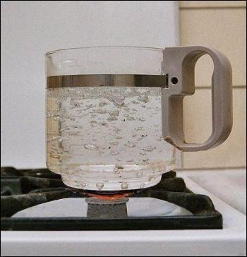
Heat Transfer
Boiling

Slide 2
Introduction
There are many important practical cases which involve heat transfer with a change of phase of the fluid,
e.g. boiling where the liquid changes to vapour and condensation where the vapour condenses into a liquid
Boiling and condensation are classified under convection since there is motion of the fluid during heat transfer in these processes.
Some of the applications of boiling and condensation are:
Evaporators and condensers of a refrigerating system
Boilers and condensers of a steam power plant
Reboilers and condensers of distillation columns of cryogenic and petrochemical plants
Cooling of nuclear reactors and rocket motors
Unique features of boiling and condensation are:
heat transfer, practically at a constant temperature, because of change of phase
high heat transfer rates with small temperature difference.

Slide 3
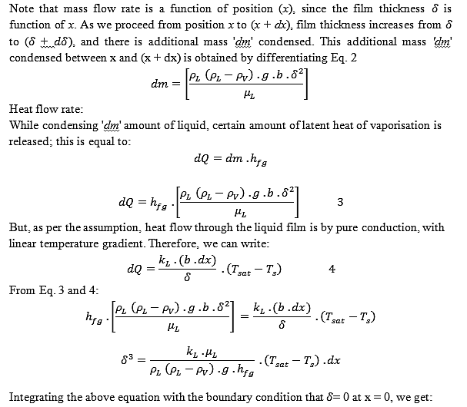

Slide 4
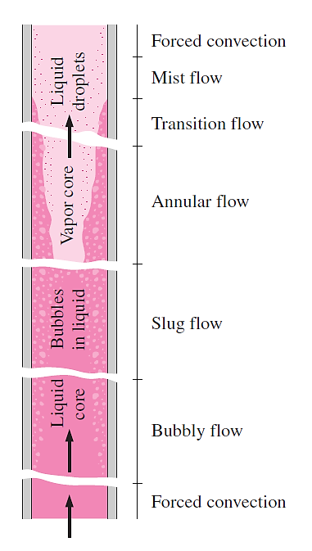
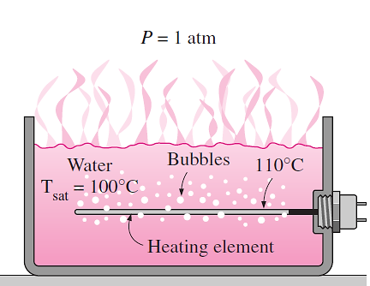

Slide 5
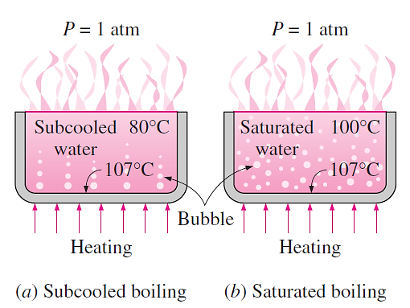

Slide 6
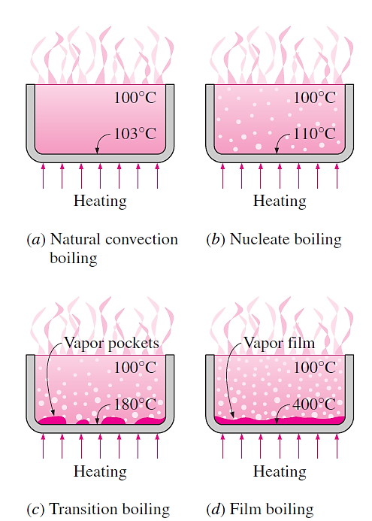

Slide 7
